Slide 1
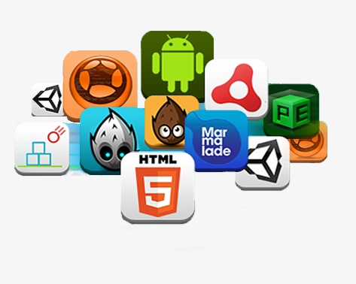
MOBILE GAME DEVELOPMENT
By Raygan KANSOY

Slide 2
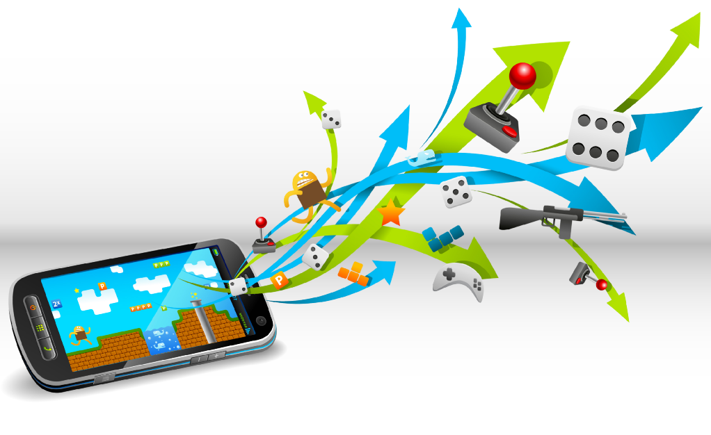
TABLE OF CONTENTS
Why Mobile Game Development?
Mobile Game Development Methodology
Mobile Game Development Phases
Some Popular Mobile Game Development Engines

Slide 3
Why Mobile Game Development?
As a result of technological developments in last 30 years, mobile phones become the integral part of our lifes.
Mobile phones started to being used not only for communication, but also for different puposes such as socializing, entertainment, education, business, health care and etc. through the millions of applicaitons available for mobiles.
The beginning of the year 2020 brought the entire world in a dire state with the spread of the Covid-19 pandemic and forced most of the countries to impose lockdown and force citizens to stay indoors for their protection. With all forms of outside activity prohibited what could the people do? →Gaming.
A new and popular mode of entertainment and an important application of technology are software games, which have become increasingly accepted by people of all ages.
Although many people see gaming as a new addiction in children and adults the circumstances that we are in now have forced even these people to change their perception and look at gaming as beneficial.

Slide 4
Why Mobile Game Development?
Even though the pandemic destroyed many businesses in across several industries, the reverse was the gaming industry’s case.
All game segments saw an increase in engagement and revenues as a result of the COVID-19 measures, but mobile gaming saw the biggest increase.
The mobile game industry was one of the highest performing industries globally in 2020 with $77.2B revenue. There is no sign of slowing down in 2021.
The mobile gaming industry recorded 12% more players in 2020 than in 2019, with over 2.5 billion players. With movement still restricted and people confined to their homes, it’s predicted that the number will only go higher this year.
Lockdown sparked a surge in the number of gamers during the second quarter of the previous year. Gamers spent more than $19 billion on mobile games in 2020’s second quarter.

Slide 5
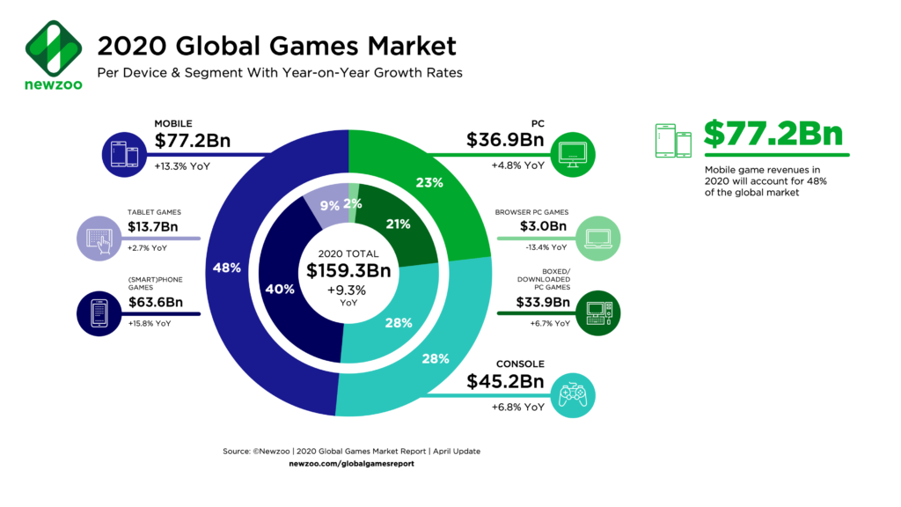
Why Mobile Game Development?
You may think to turn your love of mobile games into a career choice ! Why not..?

Slide 6
Mobile Game Development Methodology
Multidisciplinary nature of the game development processes that combine audios, visual arts, animations, control systems, artificial intelligence (AI), and human factors, makes the software game development practice different from traditional software development.
A number of methodologies used for game development and design
Agile Method, is currently the most popular and commonly used Software Engineering framework to manage the development of digital games.
This development methodology based on iterative and incremental approach.
The production phase is divided into small iterations and focusses on the most crucial features.

Slide 7
Mobile Game Development Methodology
During the beginning phase of each iteration, the whole team meets and sets clear objectives.
At the end of each iteration, results are communicated to clients.
So it also encourages teamwork and face-to-face communication.
In this methodology, development and testing activities are concurrent, unlike other software development methodologies.
The most used agile methodologies in game development are extreme programming (XP), rapid prototyping, and Scrum.

Slide 8
Mobile Game Development Phases
Pre-production, Production and Post-production are the major stages of mobile game development.
Pre-Production
Production
Post-Production
Testing
Design
Game Idea
Game
Design
Launching
Development
Idea Refinment
Test
Marketing

Slide 9
Mobile Game Development Phases
Pre-Production Phase
GAME IDEA
The process starts with a game idea. The game idea can be totally unique or may draw inspiration from other games.
The most basic questions will need to be answered, like:
What type of game are we producing?
Will it be 2D or 3D?
Will it be single player or multiplayer?
What are some of the key features it must have?
Who are its characters?
When and where does it take place?
Who is our target audience?
For which platform/s we are producing this game?
Which game engine should be used?

Slide 10
Mobile Game Development Phases
Pre-Production Phase
IDEA REFINMENT
Idea refinement is the next stage of mobile game development.
In this stage, the goal of the game and outline of the game concept should be clearly identified. Main character and side-characters shoudbe defined.
In short, it is a brief documentation of the game overview which contains four basic elements: game mechanics, setting, technology, and interaction.
Mechanics describes the rule set of the game in details by explaining the steps to reach the goal.
In Setting, two important parts are the story and aesthetic of the game. While story explains about the game, aesthetic tells the look of the game.
Technology defines the targeted devices for a particular game.
Interaction takes care of the part how the user will interact with the game.

Slide 11
Mobile Game Development Phases
Pre-Production Phase
IDEA REFINMENT
Storyline should be written and the storyboard should be developed in this stage.
A game storyboard is visual representation of storyline depicted as sketches, concept art and text explaining what happens in each scene.
The output of this stage is a "Game Design Document" that describes various game elements as well as project plans for the development.
Building the prototype of the game is the last step in this stage.

Slide 12
Mobile Game Development Phases
Production Phase
Main production involves the implementation of game concepts.
As pre-production process serves the blueprint of the game, in the production process the development process enters into a bigger phase with a large number of producers; designers, artists, sound engineers and programmers.
In the production process, they use the design of the prototype to build the game.
Concept artists create the models, textures, graphics, animation of objects, environments, and characters of different levels.
Sound engineers produce the various sounds for the game.
Then, programmers write the code based on game’s rules.
In this phase various iterations of game development loop is recommended; design, develop and test to build high quality game.
Each loop, commonly termed as sprint.

Slide 13
Mobile Game Development Phases
Production Phase
DESIGN
Designer designs game art based on desired theme.
Depending upon the iteration, the art can involve designing main game play, levels, menus, sounds, animations or promotional art.
DEVELOP
Programmers build game logic based on art designed for the iteration.
Based on the iteration, this can be developing core game play, writing AI or impementing UI/UX.
TEST
Testers validate various scenarios of gameplay to ensure higher quality of the game.
They validate each build on target platforms to provide feedbak for next iteration.

Slide 14
Mobile Game Development Phases
Post-Production Phase
The last and final phase of the game development is the post-production.
It involves testing, marketing, and game advertising.
This process first focuses on the testing.
TESTING
This stage is usually referred to as beta-testing and begins when all of the code and art has been completed.
The alpha version of the game is sent to the testing team for checking the errors or bugs.
Quality assurance team checks the game by playing it, and if they find any bugs, the games are rechecked by programmers for the necessary changes.
Once all the bugs are being fixed, or the standards are being determined, the game is being approved for the launch in the market.

Slide 15
Mobile Game Development Phases
Post-Production Phase
DEPLOYMENT
the game builts are deployed to the stores & platforms and are then officially released to the public.
MARKETING
post-production marketing is a process of promoting and selling the game
optimising game discovery including market research and advertising.

Slide 16
Some Popular Mobile Game Development Engines
It is one of the most famous game creation software among developers.
It is a cross-platform tool launched by Unity Technologies.
This platform helps you to create your own game using amazing 2D and 3D development features and work together with your team.
Unity allows importing assets from many 3D applications such as Softimage, Maya, Max, Blender, CINEMA 4D and it offers a wide range of assets that can be purchased straight from their own store.
Good for beginners (provides tutorials and guides)
Supported platforms:
iOS
Android
Windows Phone
Tizen OS
Fire OS
Some games developed using Unity: Lara Croft Go, Angry Birds 2, Pokémon Go

Slide 17
Some Popular Mobile Game Development Engines
The Unreal Engine is a game engine and editor developed by Epic Games.
It is an open and extensible platform.
It has won several awards, including the 2014 Guinness World Record.
The engine allows you to create a high-class game using Unreal Engine’s comprehensive suite of real-time 3D tools.
The toolset of Unreal Engine includes C++ code view, scripting with full source code access, hot reload functionality, virtue auto system, visual effect creation tool, customized artificial intelligence.
Some other features of Unreal Engine are; photorealistic rendering, dynamic physics and effects, lifelike animation, robust data translation, and much more.
Unreal Engine is a complete suite of development tools for anyone working with real-time technology. From design visualizations and cinematic experiences to high-quality games across PC, console, mobile, VR, and AR, Unreal Engine gives you everything you need to start and grow.
Other advantages are the easiness to work with the interface and the possibility of testing your game inside the platform.
Supported platforms:
Windows PC
Sony PlayStation 4
Xbox One
Mac OS X
iOS
Android
VR platforms
Linux
SteamOS
HTML5

Slide 18
Some Popular Mobile Game Development Engines
Solar2D, formerly known as “Corona SDK”, is a mobile game development tool that is provided to the users by Corona Labs.
With this application, users can design 2D games and apps that will work on multiple platforms.
While being relatively easy to use, Corona SDK provides additional in-depth tutorials and examples on how to create a mobile game and how to use their platform.
It also brings a real-time simulation that will help you to see how your app will look like after changes.
Corona SDK uses the same rendering engine as Cocos 2D-x, which is called OpenGL.
To make game development, even more, easier, Corona offers in-built scene management and transition library, Corona Editor, and Text plugins.
As for the scripting language, Corona uses Lua which is pretty easy to learn and code with.
While it is safe to say that this software development kit offers many features for its users to use for free, the paid enterprise model enables even more native libraries on how to make a mobile game and APIs for developers.
Supported platforms:
iOS
tvOS
Android
Android TV
macOS
Windows
Linux
HTML5

Slide 19
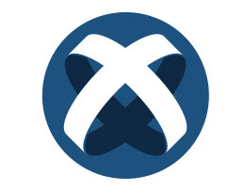
Some Popular Mobile Game Development Engines
Titanium is an open source cross platform mobile application development framework based on the magic trio- JavaScript, HTML5 and CSS3.
It is a highly extensible platform created by the company Appcelerator.
Titanium is very easy in terms of availability, use, learning, deployment and access.
With its huge library of features and user interface design objects, Titanium facilitates development of a range of interactive mobile as well as desktop web applications.
It offers more than 5.000 APIs for its different platforms.
Customized Objective-C or Java Support
AJAX and JavaScript Framework compatibility
Code chunks in the framework can be reused saving development time and cost
Allows for Rapid Prototyping
Supported platforms:
iOS
Android
Hybrid
HTML5

Slide 20
Some Popular Mobile Game Development Engines
Monogame is an open-source video game framework that operates .NET to make code manageable and reliable when it comes to cross-platform development for games.
It eliminates the need to worry about exporting the code to different machines and operating systems.
As the tool is a framework, and it is not a full-blown engine, building a game using the tool will not be a huge hassle for the developers.
If the developers are skilled at C#, it is easy to have the game developed on this platform.
Device orientation, accelerometer sensor, and multi-touch gesture points are some new features in the framework.
Supported platforms:
iOS
Windows Phone
Android

Slide 21
Some Popular Mobile Game Development Engines
Amazon Lumberyard is a free game engine toolkit launched by Amazon.
Same as the most of game development toolkits, Lumberyard provides cross-platform functionality with a possibility to create AAA (Triple-A) quality games.
AAA games or Triple-A games as they are called, refer to video games that are created by a large studio, i.e. a massive team, using a huge budget.
Some of its best features are that Lumberyard includes full C++ source code, Audiokinetic’s sound engine and networking.
Amazon’s Lumberyard graphics are stimulated with character, rendering, and many other tools to create 3D environments.
Differently, than the others, the toolkit features integration with Amazon Web Services that allow game developers to host their games on Amazon servers.
The partnership with Twitch.tv online streaming platform gives a great possibility to Lumberyards users to embrace mobile video game marketing, and get a name for yourself out there.
Supported platforms:
iOS
Android
PC
Xbox One
PlayStation4

Slide 22
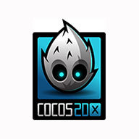
Some Popular Mobile Game Development Engines
Cocos2d-x is an open source cross-platform game development framework that supports 2D and 3D game creation.
The engine provides rich functions such as graphics rendering, GUI, audio, network, physics, user input, etc.,
Cocos2D uses C++ to build games along with support for Lua and JavaScript.
It comes with a detailed documentation and active community support.
One of its best features is that Cocos 2D-x allows you to create games that are as low as few megabytes size.
By using Android plug-in SpriteBuilder, you can prototype and build games.
Various classes of Cocos2D makes it an ultimate tool for upcoming mobile game developers; CCAction class for the move, rotate and scale, CCDirector and CCTransition class for performing scene management, CCParticleSystem to support particle systems and CCTiledMap class for tilemaps.
Supported platforms:
iOS
Android
HTML5
Windows
Mac

Slide 23
Some Popular Mobile Game Development Engines
Haxe is an open source high-level strictly-typed programming language with a fast optimizing cross-compiler.
Haxe can build cross-platform applications targeting JavaScript, C++, C#, Java, JVM, Python, Lua, PHP, Flash, and allows access to each platform's native capabilities.
It also includes a library from which you can select frameworks and choose between a wide range of functions and procedures (APIs) to develop your mobile game.
Haxe is useful in a wide variety of domains; games, web, mobile, desktop, command-line and cross-platform APIs.
Haxe compiler seamlessly compiles thousands of classes to enable speedy game development.
Supported platforms:
iOS
Android
HTML5

Slide 24
Some Popular Mobile Game Development Engines
Gideros is a set of software packages created and managed by a company named Gideros Mobile.
Gideros is an open-sourced and free platform.
It provides developers with the ability to create 2D games for multiple platforms by reusing the same code (no need to make additional changes).
Games created with Gideros run as native applications, thus having all the benefits of high performance and the utilization of the hardware power of a mobile device.
Gideros uses Lua as its programming language, which is a lightweight scripting language
Gideros most favorable feature is its rapid prototyping and fast development time by providing a single-click on-device testing that enables you to compile and run your game from your computer.
You can also test your game on a real device and in real-time.
Supported platforms:
iOS
MacOSX
Android
Windows Phone
Windows
Windows RT

Slide 25
Some Popular Mobile Game Development Engines
Godot is a game engine oriented towards both 2D and 3D game development.
One of the most important advantages of Godot is that it's free and open source.
It’s beginner-friendly.
The game engine focuses on providing a well-rounded set of tools for development – including a built-in code editor, a graphics rendering engine, audio playback tools, animation tools, and more.
Godot uses its own language, GDScript but it also supports visual scripting, C# and C++.
Godot also allows export for HTML5 for developers who wish to put their games on the web.
Supported platforms:
iOS
Android
Windows
macOS
Linux
UWP
*BSD

Slide 26
Some Popular Mobile Game Development Engines
CRYENGINE is a powerful mobile game development engine that has been created by a German company named Crytek that is mostly used to create 3D games for multiple platforms
It is an easy platform to manage for developers and provides good support.
It is known for its high-quality visuals. It offers a whole set of tools to create experiences, character animations, audio to create your mobile game.
The toolkit offers the opportunity to create an advanced games using the likes of C++, Lua, ActionScript and Visual Studio.
CRYENGINE gives developers full control over their multi-platform creations in real-time. The engine’s WYSIWYG (What You See Is What You Get) suite of tools enables real-time creation, material editing, and an in-game preview of every aspect and feature of a game.
Alongside, CryEngine offers a huge list of features for its user; packing an industry-leading renderer, real-time lighting with hardware- and API-agnostic ray tracing, and optimized VR support.
Use of the platform is free. 5% royalty when shipping the project.
Supported platforms:
All platforms

Slide 27
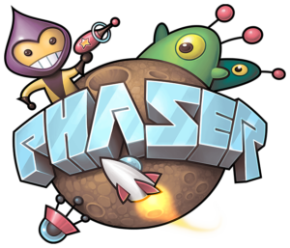
Some Popular Mobile Game Development Engines
Phaser is a 2D game framework used for making HTML5 games for desktop and mobile.
It is free software developed by Photon Storm.
One of the main strengths of the framework is its ease of use.
To get started with Phaser, all you need to know is basic HTML and JavaScript.
In order to render visually beautiful games, Phaser relies on two technologies, Canvas and WebGL.
Canvas is an HTML element supported by all modern browsers that allows for the creation of in-browser graphics, drawn from instructions often given in JavaScript.
WebGL (Web Graphics Library) is a JavaScript API for rendering high-performance interactive 3D and 2D graphics within any compatible web browser without the use of plug-ins.
By pairing Canvas with WebGL, Phaser can help you create visually pleasing environments for gamers to play in.
Supported platforms:
iOS
Android

Slide 28
Some Popular Mobile Game Development Engines
Defold is a completely free to use, cross-platform game engine for development of console, desktop, mobile and web games.
Defold comes fully featured out of the box. There's nothing to set up or configure, not even when bundling. Simply you can download the editor and start.
You can build levels, player characters, bosses, screens and user interface components all from within the editor.
Defold has a powerful animation system for visual components and scripts.
You can write all of your game logic using the Lua scripting language. (Lua is a commonly used scripting language for games with an easy to learn syntax and great performance.)
With Defold you create your game once and export to all supported platforms without making any changes.
The Defold SDK allows you to write extensions to the engine in C, C++, ObjectiveC, Java and JavaScript.
You can setup your own local build environment.
The engine is focused on 2D but also enables to develop 3D designs.
Easy integration with external tools such as Atom, Spine and Tiled.
Supported platforms:
Android
iOS
macOS
Linux
Windows
Steam
HTML5
Nintendo Switch
Facebook

Slide 29
Some Popular Mobile Game Development Engines
Starling is a cross-platform game engine.
It is an open source game framework used to create 2D games that run both on mobile and desktop platforms.
You can debug your game comfortably in the browser, then deploy it on your mobile phone.
Starling is a pure ActionScript 3 library that mimics the conventional Flash display list architecture.
In contrast to conventional display objects, however, all content is rendered directly by the GPU
If you were comfortable working with flash and actionscript 3, starling framework is an amazing way to bring your skillset in to the modern era.
Its complete documentation makes it easy to understand.
Adobe supports the development of Starling and plans to integrate it tightly into its tools.
It is totally free.
Supported platforms:
iOS
Android

Slide 30
THANK YOU...
Any Questions ?

