Slide 1
Graphical User Interface Designing and Programming
By
Asst. Prof Dr. Hasan Oylum

Slide 2
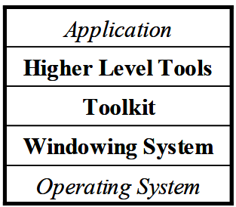
Graphical User Interface (GUI)
GUI: A form of user interface that makes significant use of the direct manipulation style using pointing with a mouse.
The components of user interface

Slide 3
Today’s GUI Design
There has been significant progress in software tools to help with creating user interfaces
Virtually all user interface software is created using tools that make the implementation easier.
Virtually all applications today are built using some form of user interface tool [Myers 2000].

Slide 4
Tomorrow’s GUI Design
Tomorrow’s user interfaces will provide:
Speech recognition
Vision from cameras,
3-D, intelligent agents and integrated multi-media
Will probably be even more difficult to create.
The only reliable way to get good interfaces is to iteratively re-design (and therefore re-implement)
the interfaces after user testing, which makes the implementation task even harder

Slide 5
Importants of GUI Design

Slide 6
Importants of GUI Design
The ACM Symposium on User Interface Software and Technology (UIST) is the premier forum for innovations in human-computer interfaces

Slide 7
Importants of GUI Design
SIGCHI Sponsored or Co-Sponsored Conferences

Slide 8
Importants of GUI Design
https://graphicsinterface.org/

Slide 9
Importants of GUI Design
Quality of the resulting user interfaces might be higher. This is because of the following:
Designs can be rapidly prototyped and implemented, possibly even before the application code is written. This, in turn, enables more rapid prototyping and therefore more iterations of iterative design that is a crucial component of achieving high-quality user interfaces [Nielsen 1993b].
The reliability of the user interface will be higher, since the code for the user interface is created automatically from a higher-level specification.
Different applications are more likely to have consistent user interfaces if they are created using the same user interface tool. It will be easier for a variety of specialists to be involved in designing the user interface, rather than having the user interface created entirely by programmers.
Graphic artists, cognitive psychologists, and usability specialists may all be involved. In particular, professional user interface designers, who may not be programmers, can be in charge of the overall design.
More effort can be expended on the tool than may be practical on any single user interface since the tool will be used with many different applications.
Undo, Help and other features are more likely to be available since the tools might support them.

Slide 10
Importants of GUI Design
The user interface code might be easier and more economical to create and maintain. This is because of the following:
Interface specifications can be represented, validated, and evaluated more easily.
There will be less code to write, because much is supplied by the tools.
There will be better modularization due to the separation of the user interface component from the application. This should allow the user interface to change without affecting the application, and a large class of changes to the application (such as changing the internal algorithms) should be possible without affecting the user interface.
The level of programming expertise of the interface designers and implementers can be lower, because the tools hide much of the complexities of the underlying system.
It will be easier to port an application to different hardware and software environments since the device dependencies are isolated in the user interface tool.

Slide 11
Higher Level Tools
Since programming at the toolkit level is quite difficult, there is a tremendous interest in higher level tools
The user interface software production process is much more easier .

Slide 12
Toolkits
A toolkit is a library of widgets that can be called by application programs. A widget (also called a control) is a way of using a physical input device to input a certain type of value.
Typically, widgets in toolkits include menus, buttons, combobox, checkbox, scroll bars, text type-in fields, etc.

Slide 13
Specialized Toolkits
The SUIT system [Pausch 1992] (which contains a toolkit and an interface builder) is specifically designed to be easy to learn and is aimed at classroom instruction
Alice [Pausch 1995], provides an easy way to program 3-D graphics and animation
Amulet [Myers 1997] provides high-level support for graphical, direct manipulation interfaces, and handles input as hierarchical command objects, making Undo easier to implement
Rendezvous [Hill 1994], Visual Obliq [Bharat 1994], and GroupKit [Roseman 1996] are designed to make it easier to create applications that support multiple users on multiple machines operating synchronously
The Brown 3-D toolkit [Stevens 1994] and the Silicon Graphics’ Inventor toolkit [Wernecke 1994] provide preprogrammed 3-D widgets and a framework for creating others

Slide 14
Higher Level Tools
Since programming at the toolkit level is quite difficult, there is a tremendous interest in higher level tools that will make the user interface software production process easier.
The design time component helps the user interface designer design the user interface
Event Languages With event languages, the input tokens are considered to be events that are sent to individual event handlers. Each handler will have a condition clause that determines what types of events it will handle, and when it is active. The body of the handler can cause output events, change the internal state of the system (which might enable other event handlers), or call application routines.
Microsoft’s Visual Basic also contains event-language features, since code is written to handle the response to events on objects
Declarative Languages Another approach is to try to define a language that is declarative (stating what should happen) rather than procedural (how to make it happen). The user interfaces supported are basically forms, where fields can be text that is typed by the user, or options selected using menus or buttons.
Constraint Languages A number of user interface tools allow the programmer to use constraints to define the user interface [Borning 1986b]. Early constraint systems include Sketchpad [Sutherland 1963], which pioneered the use of graphical constraints in a drawing editor, and Thinglab [Borning 1981], which used constraints for graphical simulation. Subsequently, Thinglab was extended to aid in the generation of user interfaces [Borning 1986b].

Slide 15
Higher Level Tools
All three paradigms have their uses, but the sweet spot for GUI programming basically lies in an appropriate mix of declarative and procedural – which is what HTML/Javascript provides.

Slide 16
Higher Level Tools

Slide 17
Higher Level Tools
jQuery is a Javascript library that you include in your HTML page

Slide 18
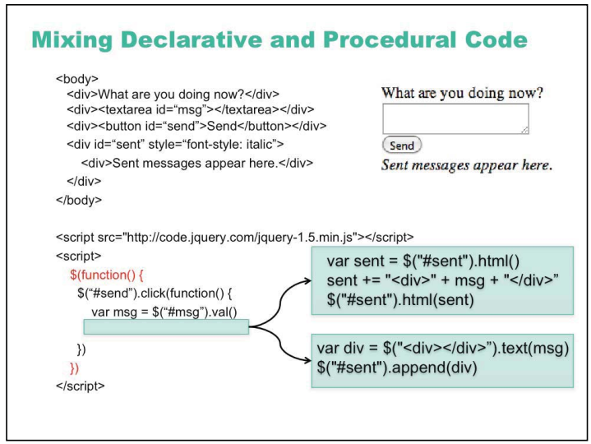
Higher Level Tools

Slide 19
Higher Level Tools
Database Interfaces A very important class of commercial tools supports form-based or GUI-based access to databases. Major database vendors such as Oracle [Oracle Tools 1995] provide tools that allow designers to define the user interface for accessing and setting data. Often these tools include interactive form editors (which are essentially interface builders) and special database languages. Fourth generation languages (4GLs), that support defining the interactive forms for accessing and entering data, also fall into this category
Visual Programming Visual programs use graphics and two (or more) dimensional layout as part of the program specification Many different approaches to using visual programming to specify user interfaces have been investigated
Examples of visual programming systems for creating user interfaces include Labview, Visual Basic from Microsoft.
Application Frameworks application framework to guide programmers. This was called the object-oriented language Object Pascal. Classes are provided for the important parts of an application, such as the main windows, the commands, etc., and the programmer specializes these classes to provide the application-specific details, such as what is actually drawn in the windows and which commands are provided.

Slide 20
Higher Level Tools
Prototyping Tools The goal of prototyping tools is to allow the designer to quickly mock up some examples of what the screens in the program will look like. The designer can easily create the various screens for the application. It is also relatively easy to specify the actions (mouse or keyboard) that cause transitions from one screen to another
For graphical user interfaces, designers often use tools like Macromedia’s Director,which is actually an animation tool
HyperCard and Visual Basic are also often used as prototyping tool
Interface Builders An interface builder allows the designer to create dialogue boxes, menus and windows that are to be part of a larger user interface. These are also called Interface Development Tools (IDTs) or GUI Builders.
Microsoft’s Visual Basic is essentially an interface builder coupled with an editor for an interpreted language.
Many of the tools discussed above, such as the virtual toolkits, visual languages, and application frameworks, also contain interface builders

Slide 21
Higher Level Tools
The technology and tools are changing quite rapidly.
More dynamic pages can use a scripting language embedded in the html, such as Javascript or VBscript (Visual Basic Script).
Alternatively, a specialized animation language can be used,such as Adobe Flash language, which might be authored using an interactive tool such as Dreamweaver.
New Programming Languages new languages, such as Java, make much of the user interface harder to program by leaving it in separate libraries. Furthermore, an integrated environment, where the graphical parts of an application can be specified graphically and the rest textually, would make the generation of applications much easier.
Today’s user interface tools mostly help with the generation of the code of the interface, and assume that the fundamental user interface design is complete.
Research in this area by cognitive psychologists and other user interface researchers is continuing

Slide 22
Higher Level Tools
End User Programming and Customization
One of the most successful computer programs of all time is the spreadsheet. The primary reason for its success is that end users can program (by writing formulas and macros).
AutoCAD provides Lisp for customization, and many Microsoft applications use Visual Basic.
Application and User Interface Separation
One of the fundamental goals of user interface tools is to allow better modularization and separation of user interface code from application code.

Slide 23
View Tree
View tree is a central feature in the architecture of every important GUI toolkit

Slide 24
Thanks for Listening
and
Have a Nice Day

